Slide 1

Making this resource work for you
Prior to teaching this lesson, please refer to the ‘Unit Overview and Planning Document’.
Further guidance on planning Science Mastery lessons can be found in the detailed planning guidance document.
Refer to the ‘notes’ section on each slide for useful information, including suggested expositions, pedagogical content knowledge, suggested questions, answers and more. Consider using presenter mode so you can see this guidance throughout the lesson.
The introduction slides can be adapted to suit your teaching style and the needs of your class.
Before the lesson, adapt the fix-it slide to address any misconceptions identified in the previous lesson’s exit ticket.
Choose from the suggested activities to suit your class. The intention is not that you complete all of these, but that you select those which ones are most appropriate for your students. It may be appropriate to further adapt activities for your students.
These lessons are designed to occupy approximately 1 hour. To adapt for a shorter or longer lesson duration we advise you to adapt the activity section accordingly.
Please consider using the final slide to send feedback about this lesson or examples of PowerPoints that you have adapted to our design team. Your feedback is used to improve Science Mastery for all of our teachers and students. We appreciate all suggestions and comments.
Thank you for reading!
The Science Mastery Team

Slide 2

Feedback Lesson
12
C
carbon
6
16
O
oxygen
8
Answer the questions below.
State the units of volume.
State what is measured in g/dm³.
Calculate the relative formula mass of carbon dioxide.
Copy and complete for these state symbols:
(s) = solid (l) = ___________ (g) = ___________ (aq) = ___________
Write the order of the 4 processes that happen when we make a soluble salt from an insoluble base and an acid.
Litres (L) or decimetres cubed (dm³)
Concentration
12 + (16 x 2) = 44
liquid
gas
aqueous
1. Neutralisation reaction
2. Filtration
3. Evaporation
4. Crystallisation
Notes:
Foundation: Explain how to calculate the relative formula mass of a compound.
Stretch: Calculate the relative formula mass of calcium carbonate. CaCO₃
Answers
Foundation: Add the relative atomic masses of all the atoms found in one molecule of the compound.
Stretch: Mr CaCO₃ = 40 + 12 + (16 x 3) = 100;

Slide 3
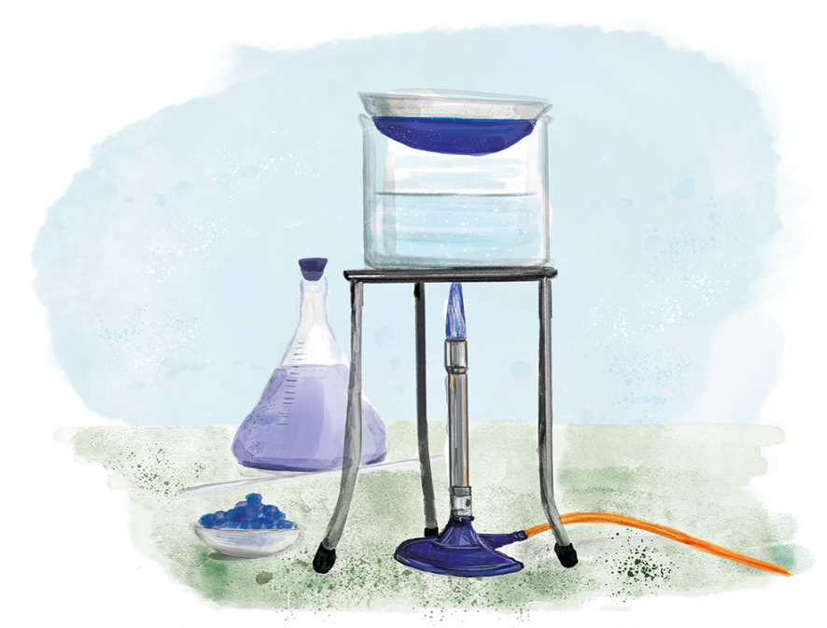

C3.2.12
25/05/2022
Feedback Lesson
C3.2.1 Prior Knowledge Review
C3.2.2 Relative Formula Mass
C3.2.3 Percentage by Mass
C3.2.4 Conservation of Mass
C3.2.5 Balancing Equations
C3.2.6 Uncertainty
C3.2.7 Introducing Concentration
C3.2.8 Concentration Calculations
C3.2.9 Soluble Salts
C3.2.10 Making Soluble Salts
C3.2.11 Making Soluble Salts 2
Notes:
This lesson links to the big idea Reactions Rearrange Matter. In this unit we started by calculating RFM and percentage by mass, using our maths skills to learn more about the amount of substances. Then we learned that mass is always conserved in chemical reactions and linked this to balancing equations. We then learned about what concentration is, the units and how to calculate concentration. Finally we applied our practical skills in a practical with many steps that allowed us to make a soluble salt using an insoluble base and acid in a neutralisation reaction.
Suggested hook:
In this unit you have developed so many skills that you need to become a chemist. A chemist is a scientist who works in the field of chemistry (not just the same word as a pharmacist who gives out medicines!). A chemist may work in industry making chemicals for food, medicine or any other product. Or a chemist may be doing new research into how chemistry works. Many of the things we have learned in this unit are used by real practicing chemists every day!

Slide 4

Following this lesson, students will be able to:
State…
Describe…
Explain…
Key Words:
concentration
mass
relative formula mass
soluble salt
Notes:
Purpose: Edit based on mastery quiz outcomes.

Slide 5
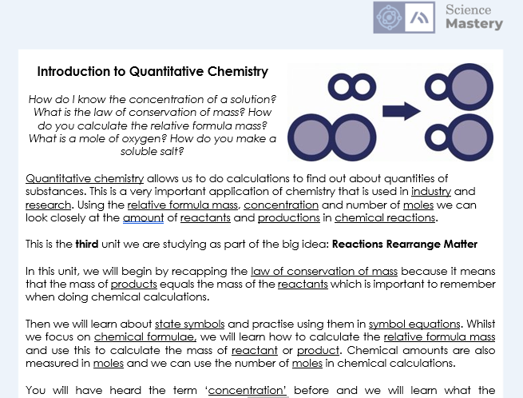
The Big Idea: Reactions Rearrange Matter
Notes:
Purpose:. The purpose of this resource is to provide students with an overview at the beginning and end of each unit. It is designed to create a discussion about the unit prior to and at the end of the sequence of lessons.
Teacher guidance:
Pupils should be directed to the C3.2 Link to Big Ideas worksheet (either in their booklet or printed). This may be back at the beginning of the sequence of lessons.
Teachers should use guided reading techniques to read aloud with the pupils and then pupils should answer the reflection questions. This could be used to summarise what pupils have learnt.
Questions on the student sheet:
1. Tick off any words in the ‘words I haven’t seen before’ column that you are now confident with. Circle any you still need more practice to use.
2. What have you most enjoyed about this unit?
3. What more would you like to learn about how reactions rearrange matter?
There are a range of ways to use this resource:
1. Display on a slide for students to read as a class. Direct students to complete the activities in their book.
2. Print off for students to stick into their book at the beginning of the unit along with their knowledge organiser. Complete as a guided reading task together. Direct students to complete the activities.
3. Have students complete as part of a booklet.
Set as a homework to reflect on the unit.
If you have any feedback about how this resource could be used/improved, please contact the science mastery team: sciencemastery@arkonline.org

Slide 6
This is the fix-it portion of the lesson
The fix-it is an opportunity to respond to gaps in knowledge, especially those identified by the previous lesson’s exit ticket.
The teacher should customise this slide as needed, to facilitate
reteach, explanation, demonstration or modelling of ideas and concepts that students have not yet grasped or have misunderstood.
practise answering specific questions or of key skills.
redrafting or improving previous work.
Notes:
Purpose: to spend time on any gaps identified in previous learning from mastery quiz.

Slide 7

Answers
Question | Answer
1
2
3
4
5
6
7
8
9
10
11
12
13
14
15
B
A
A
C
A
B
C
B
C
C
B
A
B
A
C
Notes:
Purpose: for students to correct their answers so they can see where they made errors and have a corrected quiz stuck in their books
Suggested guidance: talk through each question and cold call students to explore why the incorrect options are wrong. Students should write annotations on their marked quiz so they can revise from it.

Slide 8
Answers
Sodium chloride
The law of conservation of mass states that no atoms are lost or made during a chemical reaction, so the mass of the products equals the mass of the reactants
The interval within which the true value can be expected to lie.
Notes:
Purpose: for students to correct their answers so they can see where they made errors and have improved their Section B answers.
Suggested guidance: talk through each question and cold call students to explore why the incorrect options are wrong. Students should write annotations on their marked quiz so they can revise from it.

Slide 9
Answers
Method:
Add sulfuric acid to a beaker
Warm sulfuric acid gently placing the beaker on gauze, tripod and heatproof mat, and use a Bunsen burner
Add a small amount of solid magnesium oxide using a spatula
Stir using a glass rod
Keep adding small amounts of solid magnesium oxide using a spatula until it will no longer dissolve and remains in the beaker. This means the magnesium oxide is in excess.
Filter the mixture using a filter paper and funnel to remove excess magnesium oxide
Heat the filtrate gently in an evaporating basin until crystals start to form
Transfer the solution to a crystallising dish
Leave to crystallise for at least 1 day
Gently scrape the crystals out of the evaporating dish and pat dry with filter paper
Notes:
Purpose: for students to correct their answers so they can see where they made errors and have improved their Section B answers.
Suggested guidance: talk through each question and cold call students to explore why the incorrect options are wrong. Students should write annotations on their marked quiz so they can revise from it.

Slide 10
Complete your fix it task
Edit according to class performance on quiz
If you got Q1 or Q2 wrong…
Write the task instructions here. E.g. Complete X worksheet / write out the method / draw labelled diagrams of…
If you got Q3 wrong…
Write the task instructions here. E.g. Complete X worksheet / write out the method / draw labelled diagrams of…
If you got Q6 or Q7 wrong …
Write the task instructions here. E.g. Complete X worksheet / write out the method / draw labelled diagrams of…
Notes:
Purpose: for students to complete activities that improve their understanding of an aspect of the mastery quiz.
Guidance: These are not the only fix it tasks that might be appropriate but they are a starting point.

Slide 11
Watch the video and answer the questions
1. What are the three separation techniques involved in this practical?
Filtration
Evaporation
Crystallisation
2. What does the filtered solution contain?
Copper sulfate + water
3. What are the two safety precautions mentioned for this practical?
Wearing goggles to protect them from spitting chemicals.
Leave the evaporating dish to cool to avoid burning your hands.
Notes:
https://www.youtube.com/watch?v=iT6XH9LaJXU

Slide 12
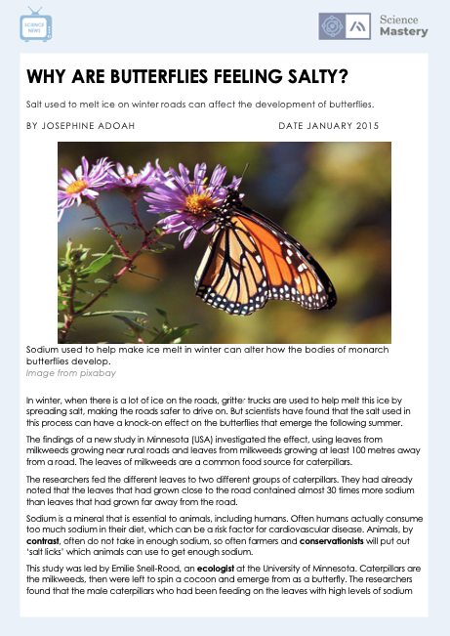
Complete the Science in the News activity

Slide 13
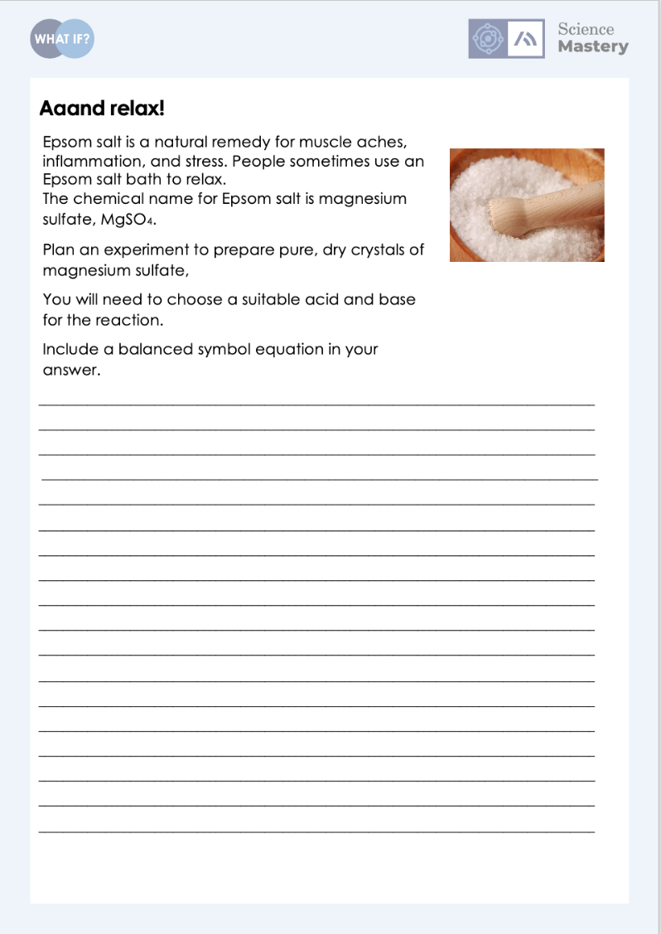
Complete the ‘What If?’ Activity

Slide 14
Answer the questions below.
What is the correct equation for calculating the mass of a substance when given the amount of substance?
A. Mass = amount of substance x Mr
B. Mass = amount of substance ÷ Mr
C. Mass = Mr ÷ amount of substance
Choose which is correctly balanced.
A. NaCl + F₂ → NaF + Cl₂
B. NaCl + F₂ → 2 NaF + Cl₂
C. 2 NaCl + F₂ → 2 NaF + Cl₂
How do you convert cm³ to dm³?
A. Divide by 1000
B. Multiply by 1000
C. Add 1000
✓
✓
✓
Notes:
Q1. Answer: A
If students answer B or C, this suggests a gap in knowledge about how to calculate the mass from the amount of substance and the Mr. To fix-it, model for how to do this calculation using an example question and then ask students to copy the correct equation out.
Q2. Answer: C
If students answer A, this suggests a complete gap in knowledge because no balancing has been attempted here. To fix-it, model how to balances this equation and then give two more examples for students to balance.
If students answer B, this suggests some attempt at balancing but the number of Na and Cl atoms have not been accounted for. To fix-it, ask students to write how many atoms of Na and Cl are in the reactants and in the products and then to use this to explain why B is not balanced.
Q3. Answer: A
If students answer B, this suggests a misconception that you need to multiply when converting a smaller quantity to a larger quantity. To fix-it, reteach this using a number line to show when you divide and when you multiply when converting units. Then give some practice examples using cm3 and dm3.
If students answer C, this suggests a gap in knowledge about converting units, because it is either multiplication or division used when converting units. To fix-it, reteach how to convert units using g to kg and kg to g and then apply this by converting cm3 to dm3 and dm3 to cm3.

Slide 15
Lesson C3.2.12
What was good about this lesson? | What can we do to improve this lesson?
Send us your feedback by clicking this link. Thank you!

